Slide 1
Testimony is an effective primary source that contextualizes historical events for students and allows them to consider the human experience. This guide will help you prepare to use testimony in meaningful learning activities.
This guide addresses the following:
The power of testimony
Guidelines, best practices, and strategies for including testimony in multidisciplinary instruction
Notes:
*Play in presentation mode to access all URLs.

Slide 2
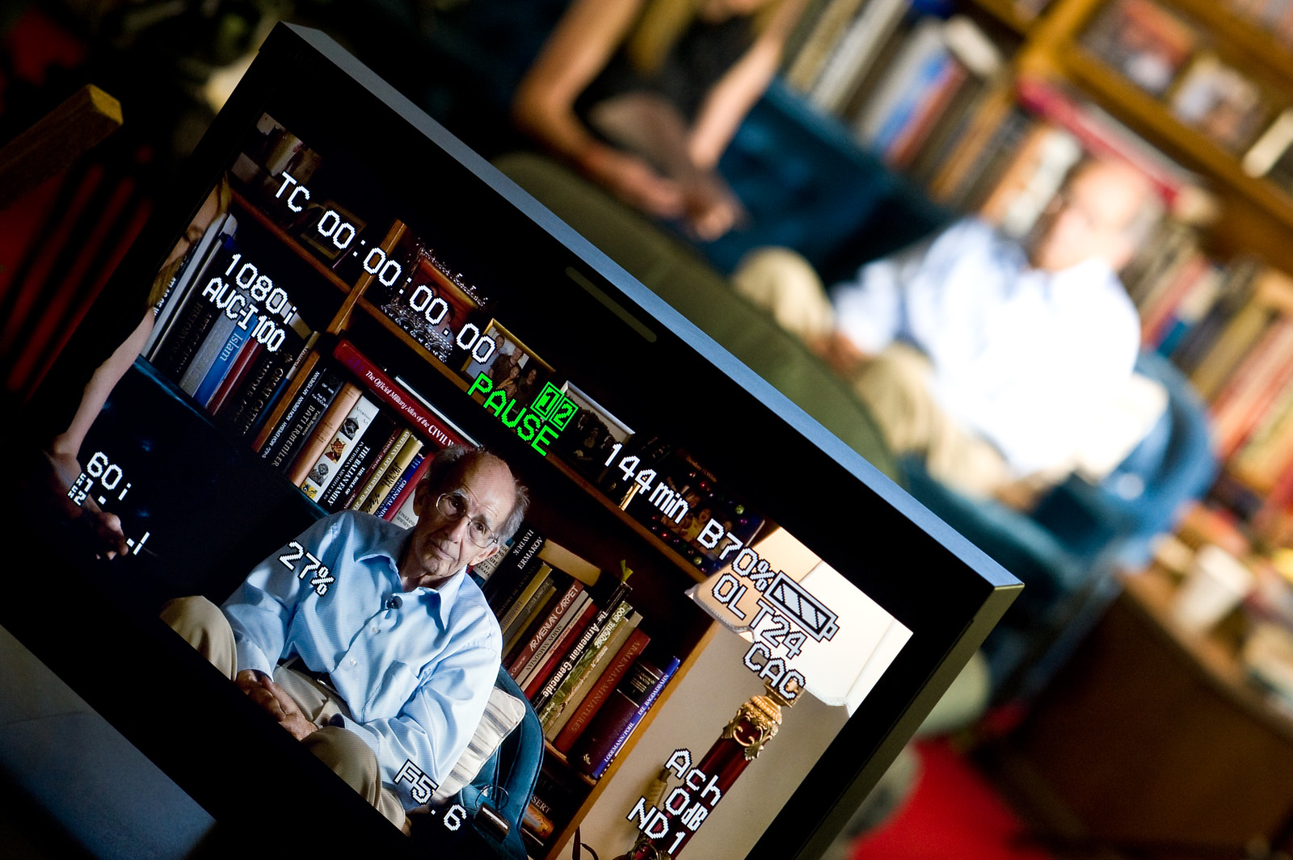
What is Testimony?
Testimony is a personal retelling of memories by someone who witnessed the events described.
Testimony provides:
First-person accounts of survivors and witnesses
A human face sharing emotions and giving voice to historic events
Authentic stories that promote civic engagement and critical thinking
A reminder of our responsibility to remember, react, and understand

Slide 3
What is Testimony?
Integrating testimony across the curriculum is a compelling way to engage students with the individuals who lived through and observed the events leading up to, during, and following genocide.
What can testimony do for my students?
Boost critical thinking
Make human that which is inhuman and make tangible that which is inconceivable
Combined with the use of other primary source documents and texts, improve understanding and empathy
Safely bring students to what may be an uncomfortable learning experience
Provide an opportunity to learn a moral message expressed in a personal manner
Inspire students to bear witness and be more responsive to prejudice, hate, and injustice in their lives
Help connect witness memories to student lives
Use personal stories to teach difficult topics of hate, racism, and intolerance
Notes:
http://www.yadvashem.org/yv/en/education/learning_environments/testimony.asp
https://iwitness.usc.edu/SFI/News/Default.aspx?nid=da76ab96-f18a-4f7d-a524-13a9d0f2d62f

Slide 4
Testimony and Learning Outcomes
Testimony is a powerful tool that can be used in any subject area. The central themes — prejudice, hate, and intolerance, as well as the importance of family, personal and group identity, justice, heritage, and standing up for the oppressed and against the oppressors — provide many opportunities for inquiry-based lessons. The following are just some examples of learning outcomes that are supported by the use of testimony in instruction:
History
Visual/Performing Arts
Make connections between people and events
Safely bring students to what may be an uncomfortable learning experience
Use historical evidence to create and answer questions
Inspire students to bear witness and be more responsive to prejudice, hate, and injustice in their lives
Ask and explore questions about changes that impacted people in the past or had enduring consequences
Use personal stories to teach difficult topics of hate, racism, and intolerance
Sociology
Investigate patterns of social inequality and how they impact people
Examine the social construction of groups and its impact on the life chances of individuals
Notes:
https://www.socialstudies.org/sites/default/files/2017/Jun/c3-framework-for-social-studies-rev0617.pdf
https://www.actfl.org/publications/all/world-readiness-standards-learning-languages/standards-summary
http://www.apa.org/education/k12/national-standards.aspx

Slide 5
Testimony and Learning Outcomes
Additional examples of learning outcomes could include:
Character Education/Leadership/ Social-Emotional Learning
Science
Understand and evaluate information
Promote ethical values
Design inquiry using observation, data interpretation and analysis, and critical thinking to examine testimony
Promote empathy and understanding of others
Engage students in questioning, thinking, feeling, and doing
World Cultures and Languages
Media and Digital Literacy
Explain the relationship between the practices and perspectives of the cultures studied
Empower students by providing them with 21st century learning tools and resources
Evaluate information and diverse perspectives
Promote technological thinking and inquiry
Advance student learning, creativity, and innovation
Notes:
https://www.socialstudies.org/sites/default/files/2017/Jun/c3-framework-for-social-studies-rev0617.pdf
https://www.actfl.org/publications/all/world-readiness-standards-learning-languages/standards-summary
http://www.apa.org/education/k12/national-standards.aspx

Slide 6
Important Considerations for Using Testimony with Students
It is important to prepare carefully when using testimony with students. The following recommendations and considerations will help you maximize the impact of testimony in your lessons and activities:
Explain that testimony is based on the memory and perspective of the witness and may not always be 100% accurate. This does not diminish the power of the testimony or its importance but may help students understand why witnesses may recall the same events differently.
Begin with an activity that helps students develop and apply the academic and emotional connections to the testimony.
Follow up with a reflection to allow students to share the connections they have drawn between the content matter they are learning, the testimony, and their personal experiences.
Establish and communicate a clear purpose for viewing the testimony.
Reiterate your rules for discussion and the importance of being respectful of others’ opinions and the witness clips.

Slide 7
Best Practices for Teaching with Testimony
Viewing testimony may be uncomfortable for students. It is important to help them understand why they are viewing testimony and to facilitate conversations and activities that support and enhance the academic as well as emotional connections they are building to the eyewitness clips.
Activate students’ background knowledge
Include a discussion about the impact of the passage of time, as testimony is given by witnesses and survivors sometimes many years after the events
Define terms and establish accepted vocabulary
Know your students and consider their backgrounds while planning lessons and activities and choosing testimony
Choose testimony carefully and ethically edit the content as needed for your students
Be sure that your instruction provides historical context for the testimony, describing the time, place, and people involved
Use testimony to teach topics other than genocide (e.g., immigration, fear, heroes, family customs, betrayal, human rights, coming of age, love, acceptance, and/or forgiveness)
Encourage students to analyze the source of information and the medium used to share the message

Slide 8
Best Practices for Teaching with Testimony
Choose from these suggestions or other similar activities to assist your students in navigating the potentially sensitive information in testimony in a safe, responsive way.
Before viewing testimony, teachers should do the following:
Provide an opening activity that helps students build a connection to personal narratives and experiences with bullying, stereotyping, prejudice, and discrimination (K-W-L, T-chart, and other graphic organizers)
Engage students in free writing and writing in response to prompts
Establish historical context and background on people, places, and events
Explain terms and give students historical background on antisemitism
Notes:
https://iwitness.usc.edu/SFI/News/Default.aspx?nid=da76ab96-f18a-4f7d-a524-13a9d0f2d62f
http://iwitness.usc.edu/SFI/Data/EducatorData/Using-Testimony-in-Classroom.pdf

Slide 9
Strategies for Teaching with Testimony
The suggested strategies on this slide and the next will help you engage students by activating background knowledge, facilitating the learning process, supporting practice and application of new knowledge and skills, and promoting reflection.
When viewing testimony, students should do the following:
When viewing testimony, teachers should do the following:
Pay attention to the speaker’s tone of voice and body language
Pause clips to allow time for students to reflect and/or record thoughts, questions, and ideas
Consider the context and perspective of the witness
Engage students in investigations using active inquiry
Focus on the personal story of the testimony as opposed to facts and figures
Be flexible to the needs of the students
Promote interdisciplinary thinking and learning through common, recurring themes
Create connections to their own lives and personal experiences

Slide 10
IWitness
After you are done exploring Teaching with Testimony, IWitness is an excellent resource to use extend the learning.
IWitness is an educational website developed by USC Shoah Foundation—The Institute for Visual History and Education that provides access to more than 2,500 full life histories and testimonies of survivors and witnesses to the Holocaust and other genocides for guided exploration. IWitness brings the human stories of the Institute's Visual History Archive to secondary school teachers and their students via engaging multimedia-learning activities.
Designed to be participatory, academic, and student-driven, IWitness addresses education standards from the Common Core State Standards Initiative (United States) and the International Society for Technology in Education, among others.
IWitness:
Provides meaningful educational activities and multimedia
Includes an encyclopedia and glossary to promote better understanding
Encourages student-centered, inquiry-based learning
Motivates students to act and responsibly participate in society
Includes features for educators, including guidelines and tips for integrating video testimony into lessons and projects
Notes:
www.teachingwithtestimony.com
http://iwitness.usc.edu/SFI/

Slide 11
Get Started with IWitness
IWitness is free for educators. Visit the IWitness website to register.
After registering, do the following:
Watch the Connections Videos on the dashboard
Create a student group
Browse or search ready-made activities, which are easily customizable for your students
Teach with testimony clips and assign activities to your students
Connect with other educators to share ideas and answer questions
Search testimonies by names, places, time periods, and other topics
Participate in webinars and other online trainings provided through IWitness and Echoes & Reflections
Click on “Watch” for a list of 50+ topics with curated witness clips
Notes:
http://iwitness.usc.edu/SFI/
https://echoesandreflections.org/prepare/

Slide 12
Additional Resources
Using Visual History Testimony in the Classroom
USC Shoah Foundation’s professional development video, Constructivist Theory and the Use of Video Testimony in Education
IWitness: About Us
Professional Development Videos on the Holocaust
Notes:
http://iwitness.usc.edu/SFI/Data/EducatorData/Using-Testimony-in-Classroom.pdf
https://sfi.usc.edu/education/professional-dev
http://iwitness.usc.edu/SFI/About.aspx
https://echoesandreflections.org/video_toolbox/

